Slide 1
Concurrency in Ruby
Las Vegas Ruby Meetup
2012-10-10
David Grayson

Slide 2

src
Notes:
Concurrency = multiple tasks whose timeframes overlap.

Slide 3
Basic Concurrency with a loop
task1 = ...
task2 = ...
task3 = ...
while true
if task1.needs_attention?
task1.service
end
if task2.needs_attention?
task2.service
end
if task3.needs_attention?
task3.service
end
end
Notes:
- Microcontrollers
- #service must return fast, so it's hard
- EventMachine (task=fd, uses epoll)
- Fibers

Slide 4
Threads
Keeps track of a position in the code
Main thread
Additional threads

Slide 5
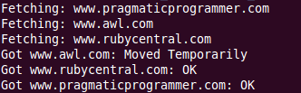
Thread Example
require 'net/http'
pages = %w( www.rubycentral.com www.awl.com
www.pragmaticprogrammer.com )
threads = []
pages.each do |page|
threads << Thread.new do
print "Fetching: #{page}\n"
resp, data = Net::HTTP.get_response(page, '/')
print "Got #{page}: #{resp.message}\n"
end
end
threads.each do |thread|
thread.join
end

Slide 6
About Threads
Threads belong to a process
Share memory with other threads
MRI: user-space threads
Jruby and Rubinius: OS threads

Slide 7
Visualizing threads
2nd thread
main thread
time

Slide 8
Basic Thread operations
Thread.start { … }
Thread.current
Kernel#sleep
stop
wakeup and run
kill/terminate/exit
raise
join
value
status
Thread-local variables
Notes:
sleep prevents your thread from using 100% CPU, avoids thread starvation
stop makes the thread ineligible for scheduling
Some subtle difference between wakeup and run

Slide 9
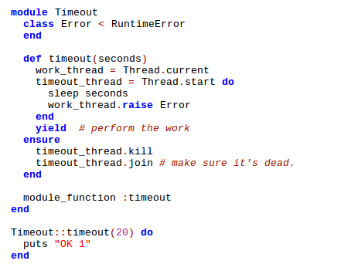
Implementing Timeout

Slide 10
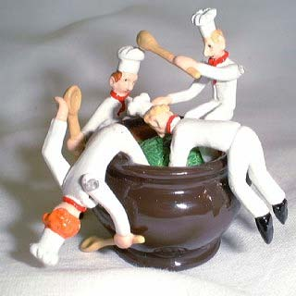
Data Safety

Slide 11

Mutex
Mutual Exclusion

Slide 12

ConditionVariable

Slide 13
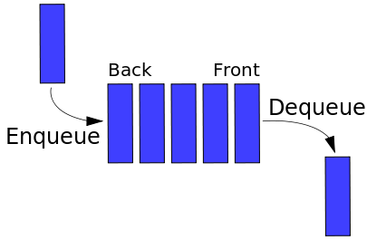
Queue

Slide 14

Celluloid / Actors
"I thought of objects being like biological cells and/or individual computers on a network, only able to communicate with messages"
--Alan Kay, creator of Smalltalk, on the meaning of "object oriented programming"

Slide 15
Drawbacks of Celluloid
Strange new behavior of ruby objects
Unclear which objects should be actors
Hard to step through in a debugger?
Hard to get a good stack trace?
Overhead?
Methods can still access same data concurrently by default!

Slide 16
Conclusion
Main tools of concurrency:
  Thread
  Mutex
Helper classes written in Ruby:
  ConditionVariable
  Queue
Other concurrency topics:
  Reactors (eventmachine)
  Actors (Celluloid)
  Fibers
  Akka
  dataflow

